Slide 1

Python project Nimitt Sharma 2023
Under the Guidance of –
My teacher & Inspiration
Mr. Sunil Kumar Sharma

Slide 2
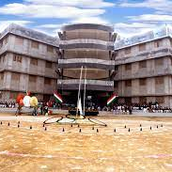
Our School had a strength of near about 5000 Students.
Difficulty in Managing such a Large Data on papers
Also tracking of The Alumini Students

Slide 3

"Every Great Thing Starts with an Idea"

Slide 4
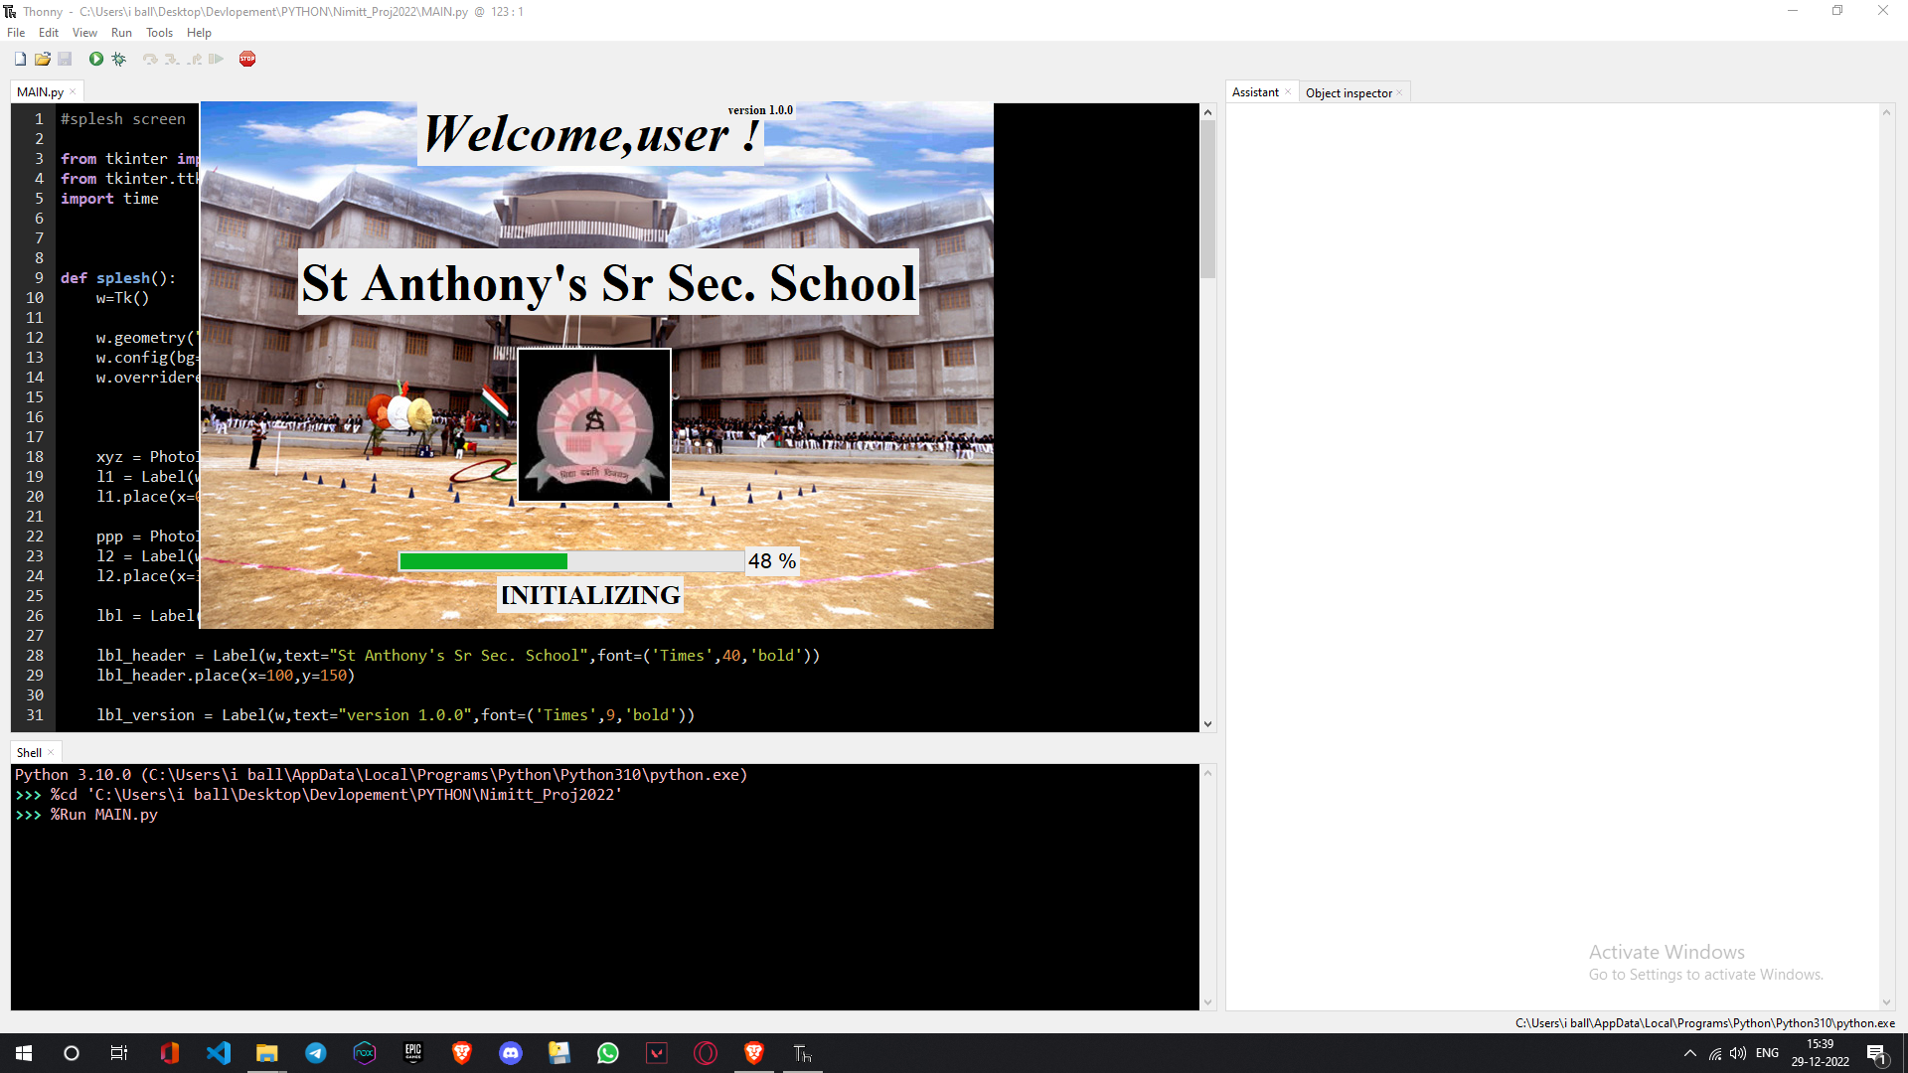
Splash Screen
Display The First Look of the project
Loading bar & versions info

Slide 5
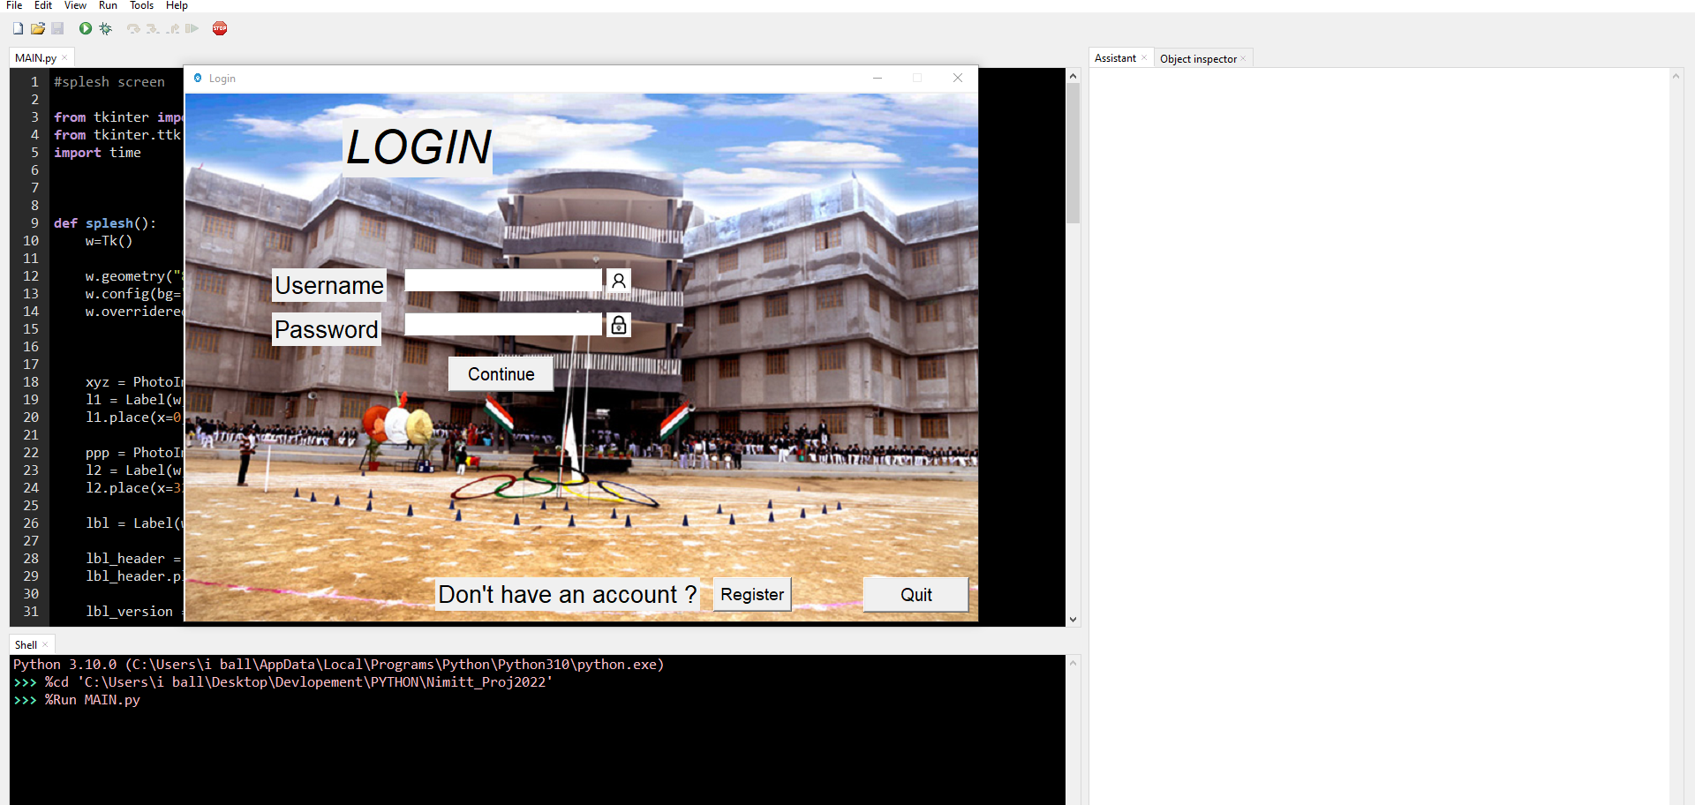
Log-in Screen
Window for logging in
Checks Username & Password
Also an Option for REGISTER

Slide 6
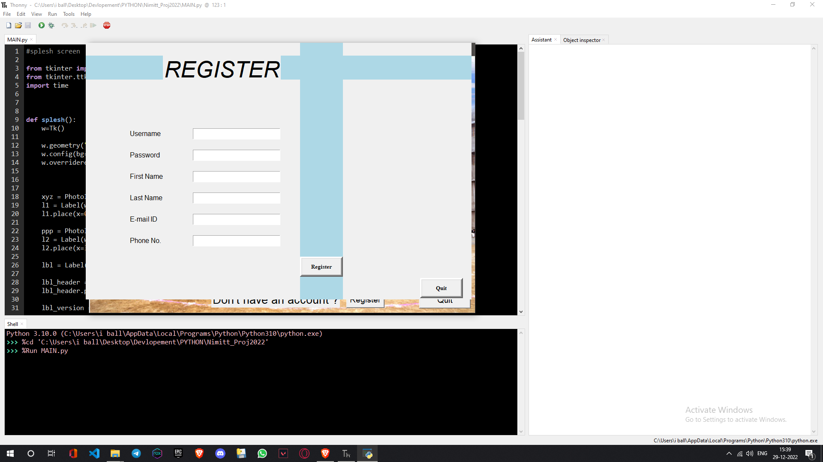
Registration Screen
Adds all the details given by Teacher
SQLITE used for data storing
Easy To use & Compactible to any System
Works without activating MYSQL services

Slide 7
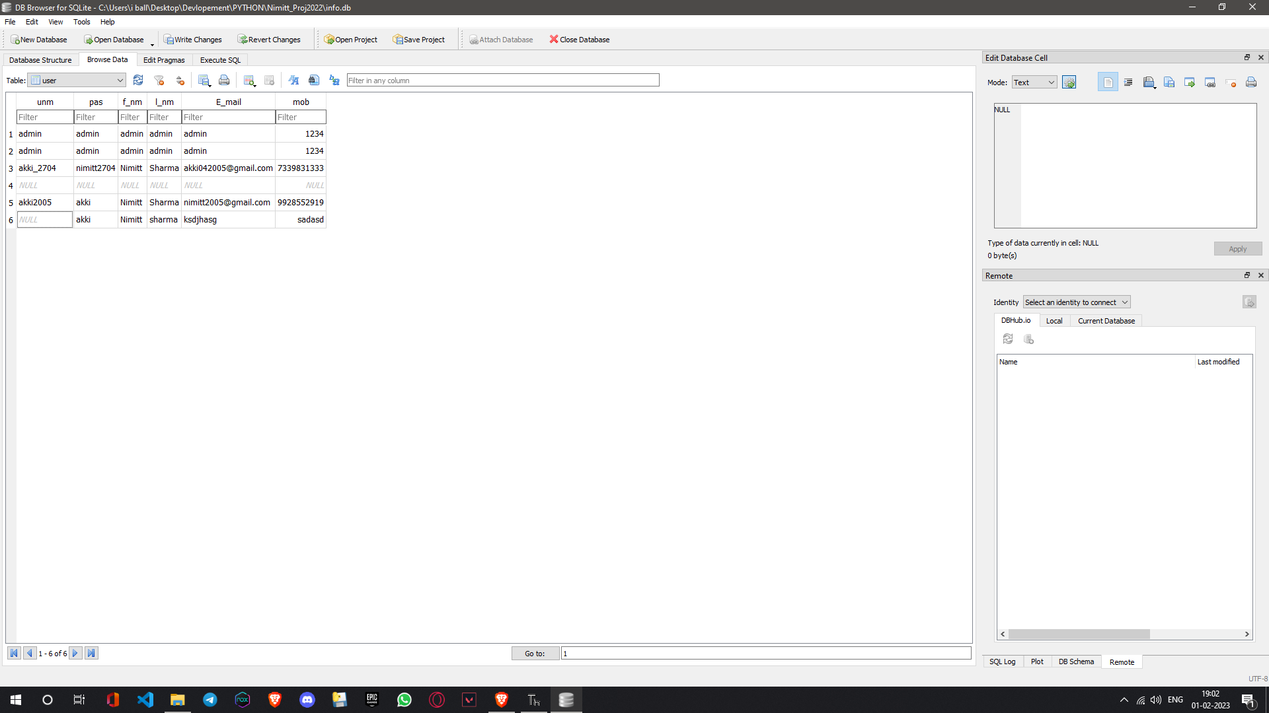
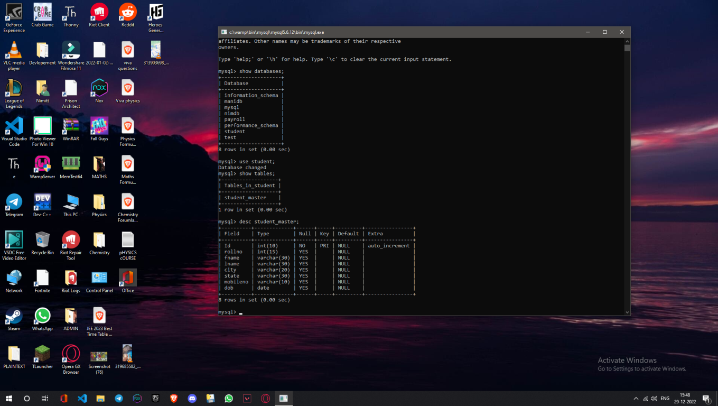
Databases : MYSQL & SQLITE3
Any Time edit Any time use
Flexible with both usernames and E-mail
Always saves a backup in case of corruption

Slide 8
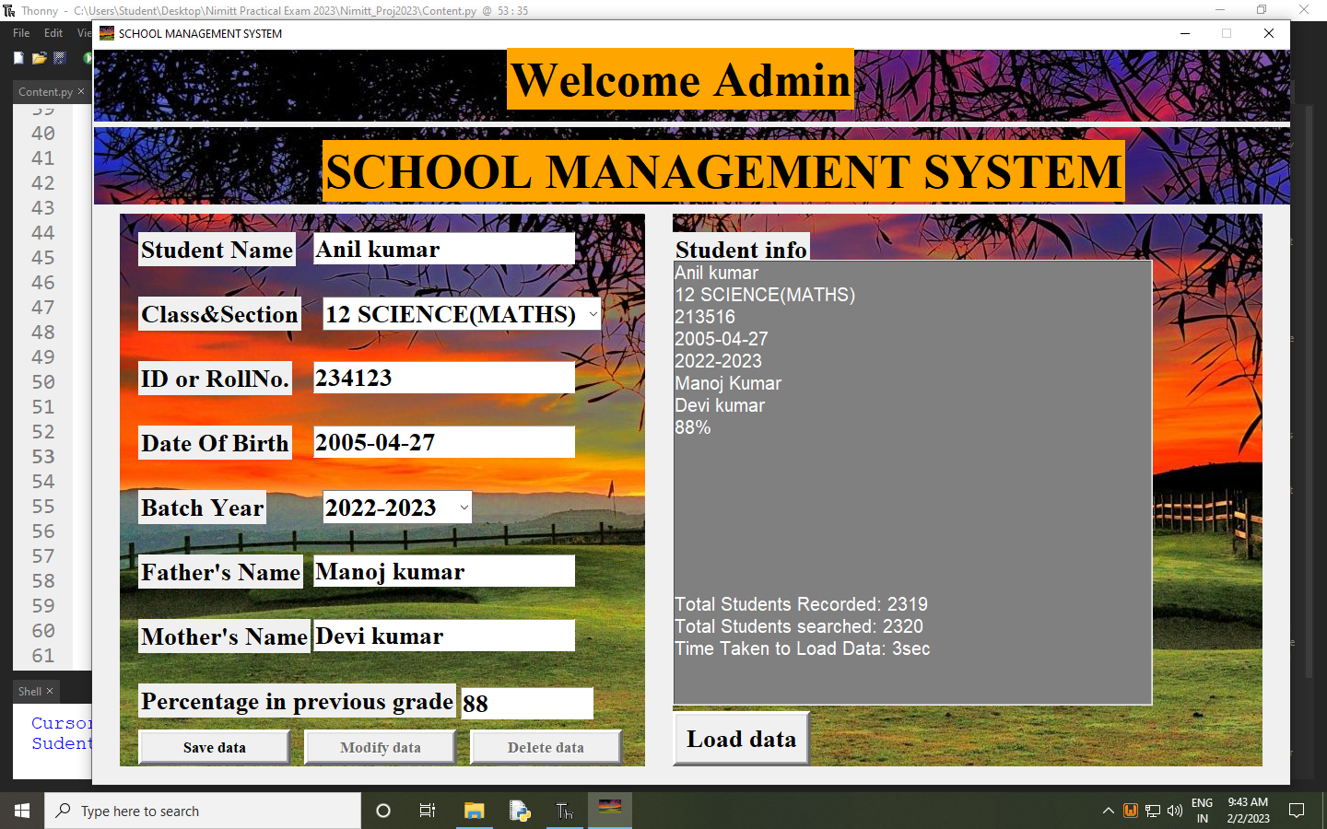
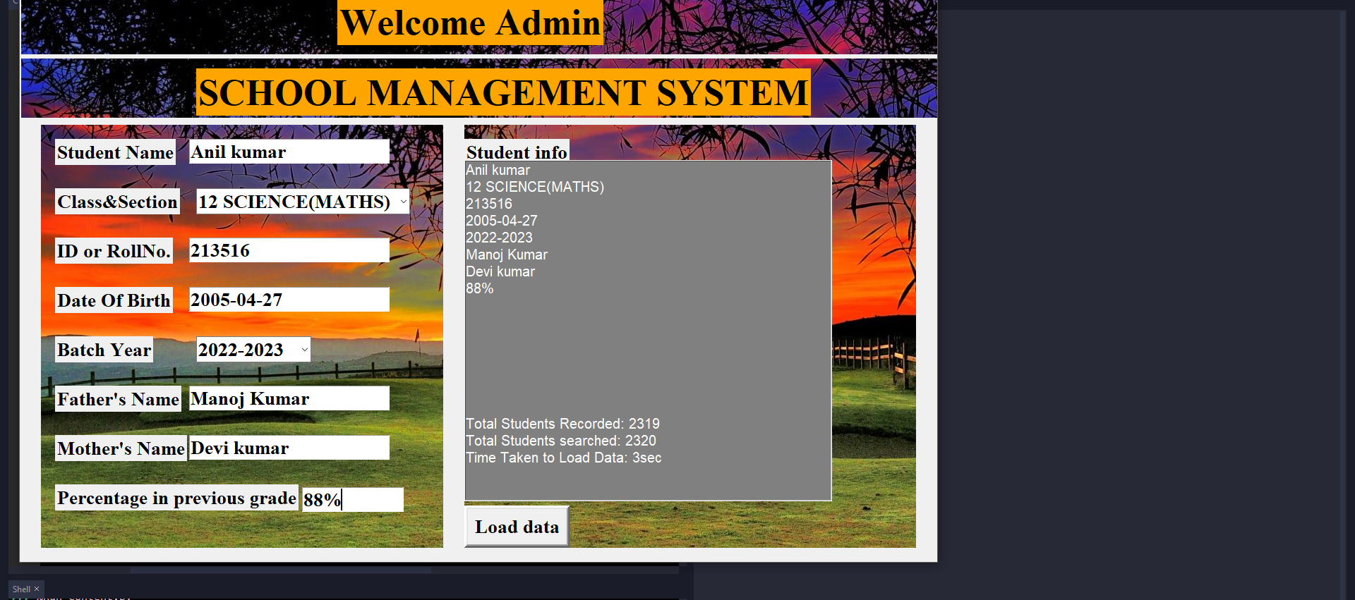
Easy To Use
Memory compactible
Large Data can be stored
Roll no.& Id is created as a foreign key to search record more easily
Open source can run on any device if converted to .exe Format
Main Content

Slide 9


Thank You For Your Time

Slide 10

Any Questions ?

